Slide 1


Global Banking & Stock Market Analysis
Comprehensive analysis of major banks and stocks across global markets.
by Aqib Tareen

Slide 2
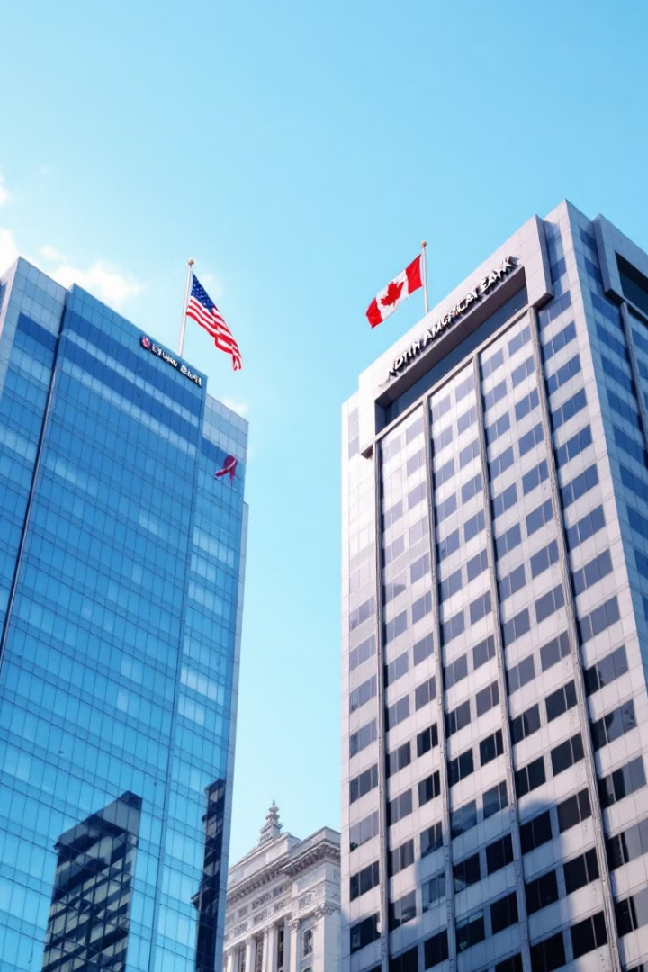
North American Banking Sector
US Giants
Investment Banks
JPMorgan Chase, Bank of America, Wells Fargo, Citigroup
Morgan Stanley, Goldman Sachs
Canadian Leaders
Toronto-Dominion, Royal Bank of Canada, Bank of Montreal

Slide 3






European Banking Landscape
Continental Europe
BNP Paribas, Deutsche Bank, Santander
UK Banks
HSBC, Lloyds Banking Group
Nordic & Swiss
ING Groep, UBS Group

Slide 4




Asian Banking Powerhouses
Japanese Banks
Chinese Banks
Hong Kong
Mitsubishi UFJ, Sumitomo Mitsui, Mizuho Financial
ICBC, Bank of China, Ping An Bank
Hang Seng Bank, Tencent Holdings, AIA Group

Slide 5
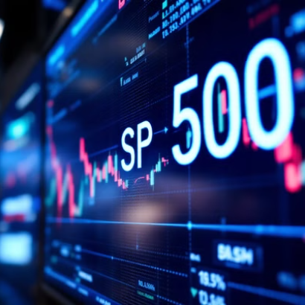
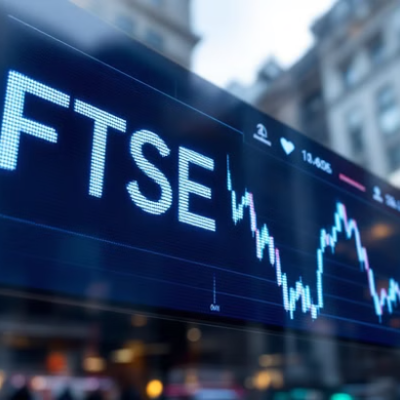
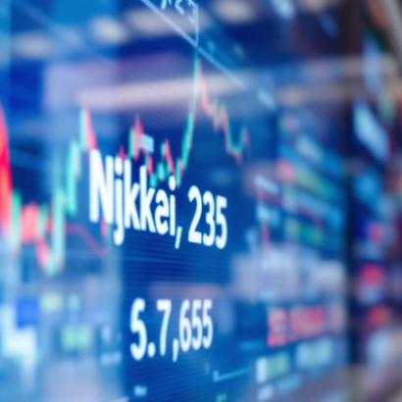
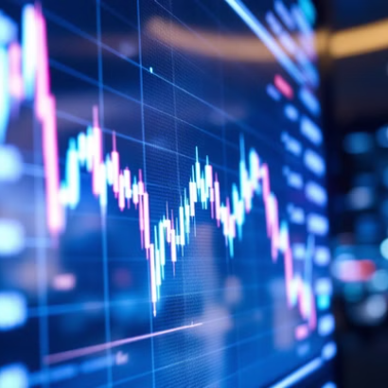
Major Stock Indices
Key global indices: S&P 500, FTSE, Nikkei 225, NSE

Slide 6




Tech Giants & Blue Chip Stocks
Tech Leaders
Industrial Giants
Apple, Microsoft, Amazon, Google, Tesla, Netflix
Toyota, Sony, BP, Shell, Rio Tinto
Consumer Brands
Coca-Cola, PepsiCo, P&G, Unilever

Slide 7
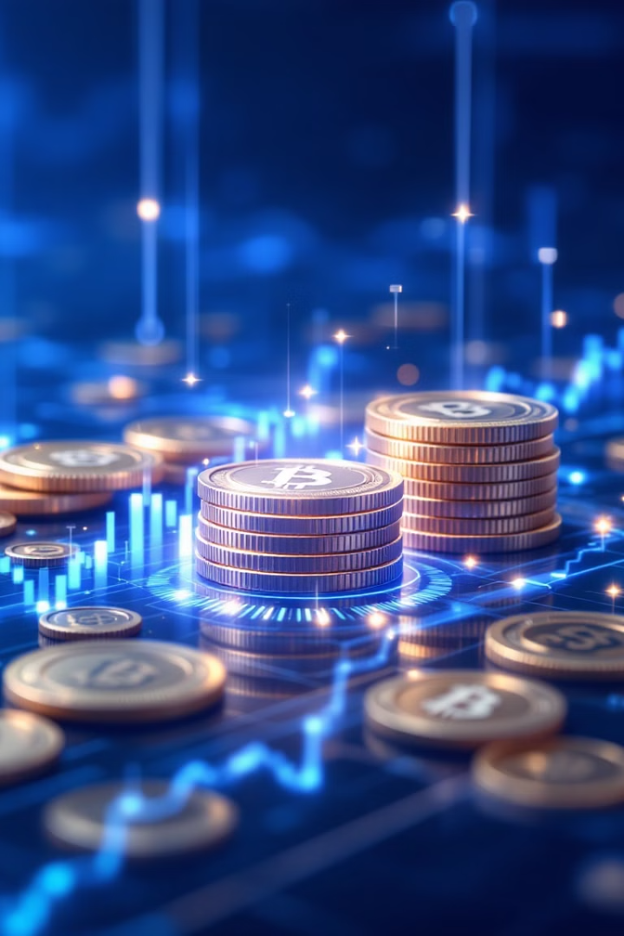



Cryptocurrency Market
Major Cryptocurrencies
Bitcoin, Ethereum, XRP, Litecoin, Dogecoin
Stablecoins
USD Coin, Dai, Binance USD, TrueUSD
Blockchain Technology
Underlying foundation for all cryptocurrencies

Slide 8
List Of Banking Stocks
Europe Banks
HSBC Holdings (HSBA.L)
BNP Paribas S.A. (BNP.PA)
Deutsche Bank AG (DBK.DE)
Banco Santander S.A. (SAN.MC)
ING Groep N.V. (INGA.AS)
UBS Group AG (UBSG.SW)
Banco Bilbao Vizcaya Argentaria S.A. (BBVA.MC)
Lloyds Banking Group (LLOY.L)
Crédit Agricole S.A. (CS.PA)
Bayerische Motoren Werke AG (BAYN.DE)
South America Banks
Itaú Unibanco Holding S.A. (ITUB)
Banco Bradesco S.A. (BBD)
Banco Santander Brasil S.A. (BSBR)
Banco do Brasil S.A. (BBAS3.SA)
Banco Santander (SANB11.SA)
Banco Bradesco (BBDC4.SA)
Itaúsa (ITSA4.SA)
North America Banks
JPMorgan Chase & Co. (JPM)
Bank of America Corporation (BAC)
Wells Fargo & Company (WFC)
Citigroup Inc. (C)
Morgan Stanley (MS)
Goldman Sachs Group, Inc. (GS)
Toronto-Dominion Bank (TD)
Royal Bank of Canada (RY)
Bank of Montreal (BMO)
U.S. Bancorp (USB)
Africa Banks
Standard Bank Group Limited (SBK.JO)
Nedbank Group Limited (NED.JO)
FirstRand Limited (FSR.JO)
Absa Group Limited (ABG.JO)
Satrix Top 40 Portfolio (STX40.JO)
MTN Group Limited (MTN.JO)
Naspers Limited (NPN.JO)
AngloGold Ashanti Limited (ANG.JO)
Impala Platinum Holdings Limited (IMP.JO)
Anglo American (AGL.JO)
Asia Banks
Mitsubishi UFJ Financial Group, Inc. (8306.T)
Sumitomo Mitsui Financial Group, Inc. (8411.T)
Mizuho Financial Group, Inc. (8316.T)
Industrial and Commercial Bank of China Limited (1398.HK)
Bank of China Limited (3988.HK)
Ping An Bank Co., Ltd. (000001.SZ)
Hang Seng Bank Limited (2800.HK)
Tencent Holdings Limited (0700.HK)
AIA Group Limited (1299.HK)

Slide 9
List of main stocks from different exchange
NASDAQ Stocks
Apple Inc. (AAPL)
Tesla Inc. (TSLA)
Amazon.com Inc. (AMZN)
Alphabet Inc. (Class A) (GOOGL)
Netflix Inc. (NFLX)
Microsoft Corporation (MSFT)
Cisco Systems, Inc. (CSCO)
The Coca-Cola Company (KO)
PepsiCo Inc. (PEP)
Procter & Gamble Company (PG)
S&P 500 Index (^GSPC)
Nikkei Stocks
Toyota Motor Corporation (7203.T)
Sony Group Corporation (6758.T)
Mizuho Financial Group, Inc. (8316.T)
Mitsubishi UFJ Financial Group, Inc. (8306.T)
Nintendo Co., Ltd. (7974.T)
Mitsubishi Estate Co., Ltd. (8801.T)
Dai Nippon Printing Co., Ltd. (6902.T)
Fujitsu Limited (4689.T)
Takeda Pharmaceutical Company Limited (4502.T)
Nikkei 225 Index (^N225)
NSE Stocks
Reliance Industries Limited (RELIANCE.NS)
Tata Motors Limited (TATAMOTORS.NS)
Housing Development Finance Corporation Limited (HDFCBANK.NS)
Infosys Limited (INFY.NS)
ICICI Bank Limited (ICICIBANK.NS)
Suzlon Energy Limited (SUZLON.NS)
Jubilant Industries Limited (JUBLINDS.NS)
ITC Limited (ITC.NS)
Vodafone Idea Limited (IDEA.NS)
Tata Consultancy Services Limited (TCS.NS)
Hindustan Unilever Limited (HINDUNILVR.NS)
NSE Index (^NSEI)
FTSE Stocks
HSBC Holdings (HSBA.L)
BP (BP.L)
Royal Dutch Shell (SHEL.L)
Anglo American (AAL.L)
Rio Tinto Group (RIO.L)
Unilever (ULVR.L)
National Grid (NG.L)
AstraZeneca (AZN.L)
Legal & General Group (LGEN.L)
FTSE Index (^FTSE)
Cryptocurrency
Bitcoin (BTC-USD)
Ethereum (ETH-USD)
XRP (formerly Ripple) (XRP-USD)
Litecoin (LTC-USD)
Dogecoin (DOGE-USD)
USD Coin (USDC-USD)
Dai (DAI-USD)
Binance USD (BUSD-USD)
TrueUSD (TUSD-USD)

Slide 10

Thank You

